Slide 1
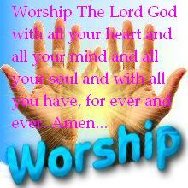
Orderly Worship
1 Corinthians 14:26-40
Dr. Rick Griffith • Crossroads International Church Singapore
cicfamily.com & BibleStudyDownloads.org

Slide 2
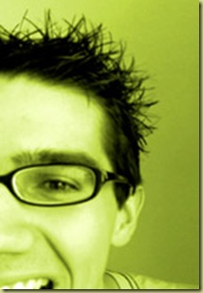
Interesting Names
Warren
Peace
Paige
Turner
Eileen
Dover
Carl
Arm
Chris B.
Bacon
Justin
Case
Notes:
2

Slide 3

Our Orderly God
Notes:
3

Slide 4
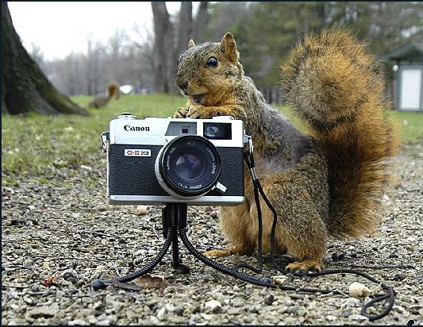
God’s Creative Order 1
Notes:
4

Slide 5
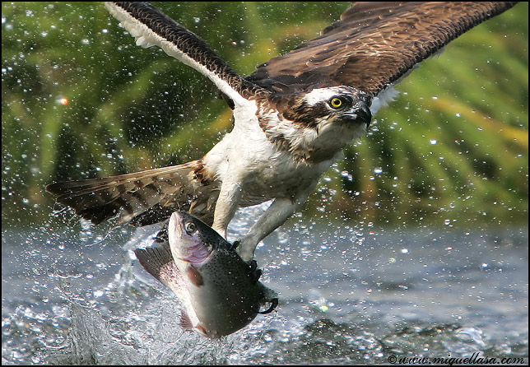
God’s Creative Order 2
Notes:
5

Slide 6
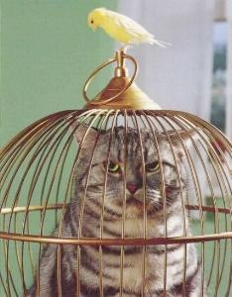
God’s Creative Order 3
Notes:
6

Slide 7
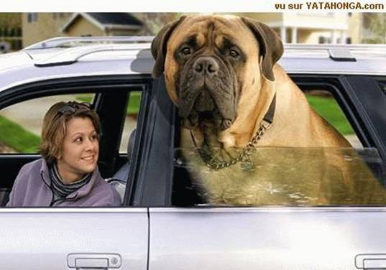
God’s Creative Order 4
Notes:
7

Slide 8
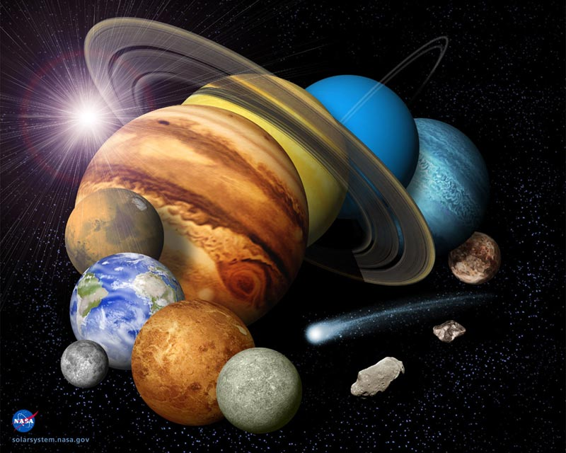
God’s Creative Order 5
Notes:
8

Slide 9

God’s Creative Order 6
Notes:
9

Slide 10

God’s Creative Order 7
Notes:
10

Slide 11
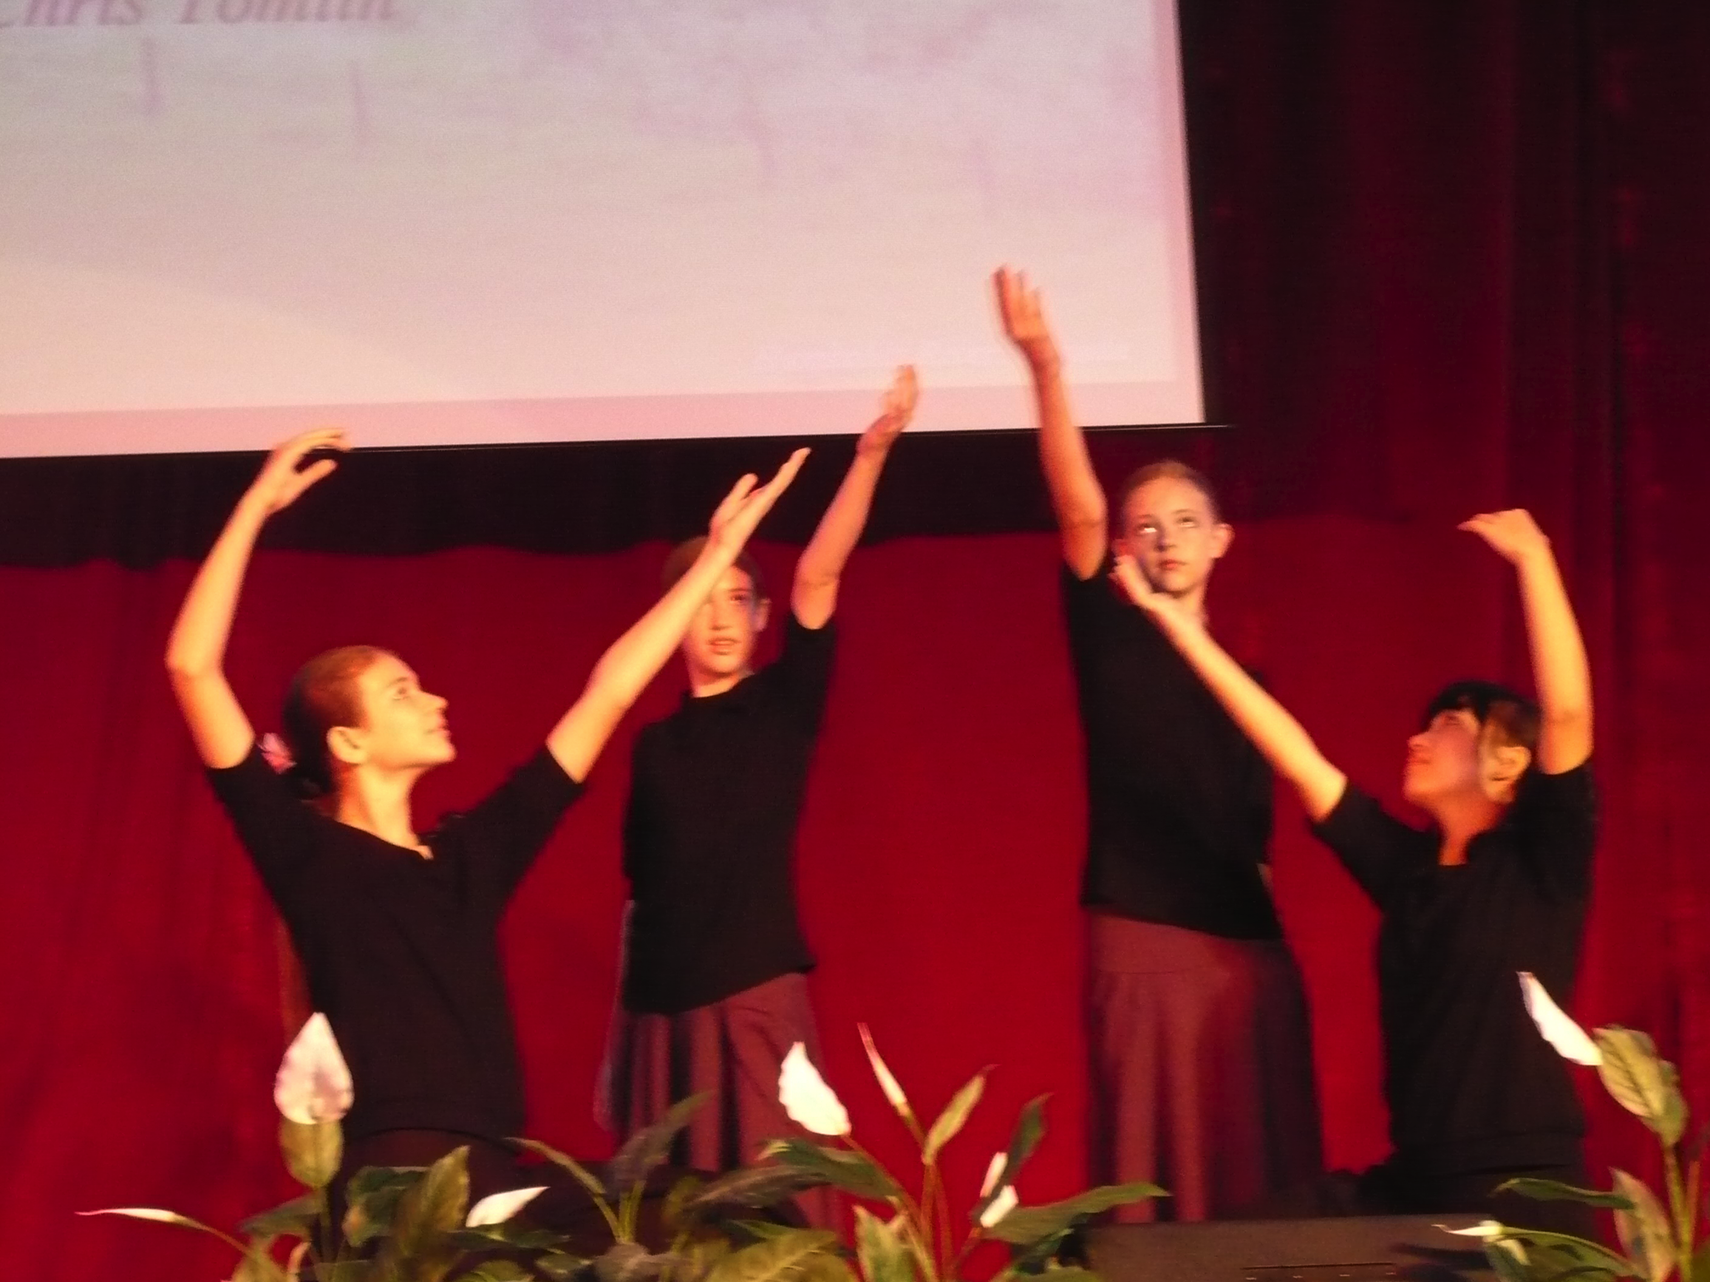
God’s Creative Order 8
Notes:
11

Slide 12
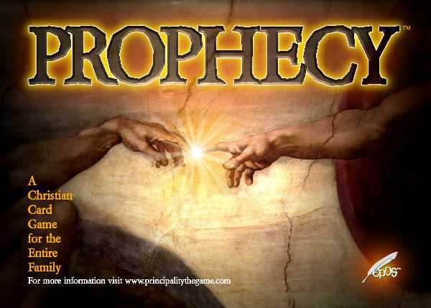

Last Week:
Reasons to emphasize prophecy over tongues (14:1-25)
over
Today:
How we can maintain order
in our services
(3 ways in 14:26-40)
TONGUES
Notes:
12

Slide 13
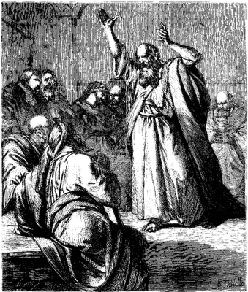
I. Speakers best edify the church by taking turns
(26-35)
Notes:
13

Slide 14
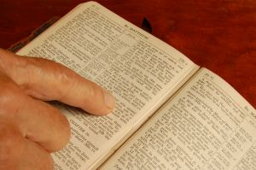
A. Everything said in our services should edify the church (26)
²⁶ Well, my brothers and sisters, let’s summarize. When you meet together, one will sing, another will teach, another will tell some special revelation God has given, one will speak in tongues, and another will interpret what is said. But everything that is done must strengthen all of you (NLT).
Notes:
14

Slide 15
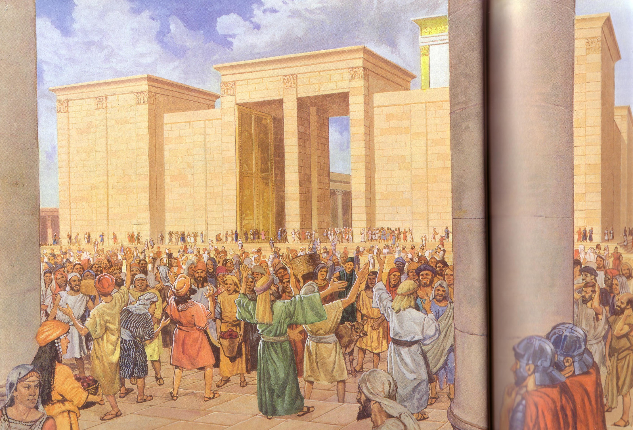
Apostles praised God in languages they had never learned (Acts 2)
Egyptian
Persian
Arabic
Median
Latin
Etc.

Slide 16


Purpose for Jewish Unbelievers
In the Law it is written:
“Through men of strange tongues and through the lips of foreigners I will speak to this people [Jews], but even then they will not listen to me,” says the Lord.
Tongues, then, are a sign, not for believers but for unbelievers;
prophecy, however, is for believers,
not for unbelievers.
1 Corinthians 14:21-22
Notes:
16

Slide 17
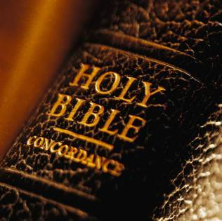
A Biblical Definition of Tongues
29
“The God-given ability to speak divine revelation in a foreign language by the speaker to unbelieving Jews in their language as a sign that a gifted interpreter can translate to edify the church”
Notes:
17

Slide 18
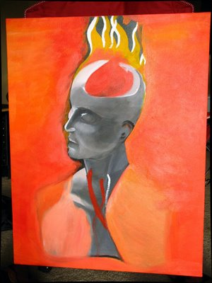
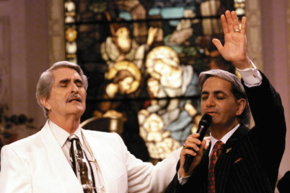
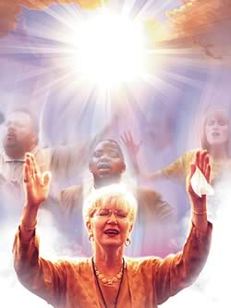
Today:
Real Languages?
For Unbelievers?
Notes:
18

Slide 19
B. Tongues speakers should take turns and be interpreted (27-28)
²⁷No more than two or three should speak in tongues. They must speak one at a time, and someone must interpret what they say.
²⁸But if no one is present who can interpret, they must be silent in your church meeting and speak in tongues to God privately
[lit. “to himself and to God”] (NLT).
Notes:
19

Slide 20
Black
Notes:
20

Slide 21
C. Prophets should take turns and be evaluated by other prophets (29-33a)
²⁹Let two or three people prophesy, and let the others evaluate what is said. ³⁰But if someone is prophesying and another person receives a revelation from the Lord, the one who is speaking must stop. ³¹In this way, all who prophesy will have a turn to speak, one after the other, so that everyone will learn and be encouraged. ³²Remember that people who prophesy are in control of their spirit and can take turns. ³³For God is not a God of disorder but of peace (NLT).
Notes:
21

Slide 22
Prophecy

Slide 23

Lord of the Rings 1
Notes:
23

Slide 24

Lord of the Rings 2
Notes:
24

Slide 25
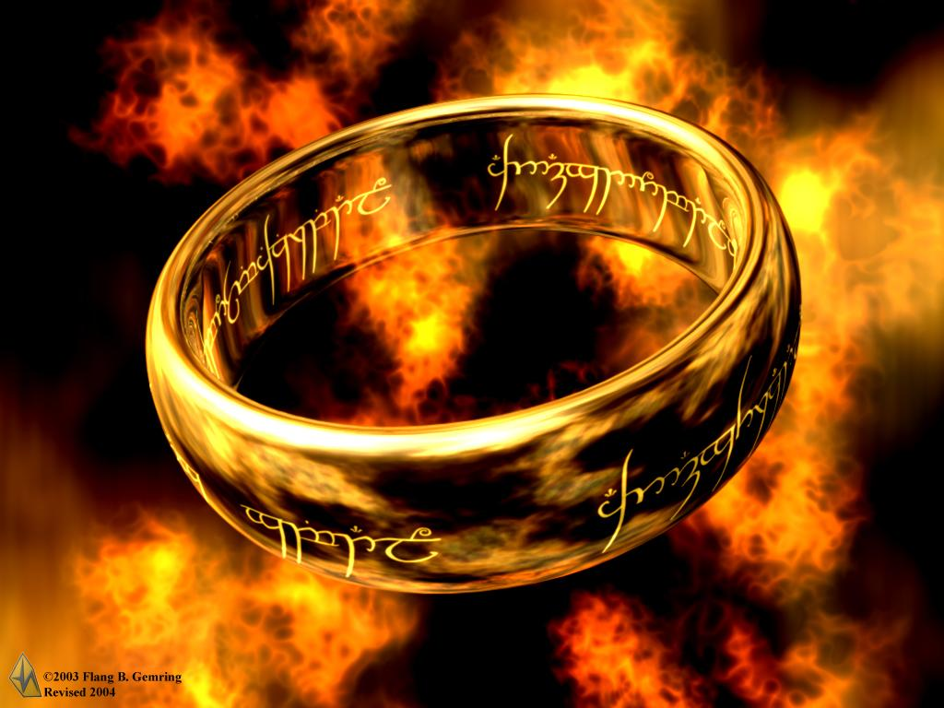
Lord of the Rings 3
Notes:
25

Slide 26

PROPHECY
“the special ability to receive revelation from God and communicate this in an immediate message to His people by speaking His words without error”

Slide 27

Tests of a True Prophet (Deut. 18:20, 22)
Predictions 100% true
Worships the LORD
“But any prophet who falsely claims to speak in my name or who speaks in the name of another god must die…If the prophet speaks in the Lord's name but his prediction does not happen or come true, you will know that the Lord did not give that message. That prophet has spoken without my authority and need not be feared.”

Slide 28
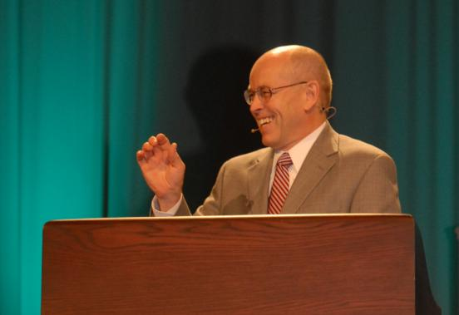
Wayne Grudem's Definition of Prophecy
“telling something that God has spontaneously brought to mind”
“Why Christians Can Still Prophesy” Christianity Today (16 Sept 1988), 29

Slide 29
C. Prophets should take turns and be evaluated by other prophets (29-33a)
²⁹Let two or three people prophesy, and let the others evaluate what is said. ³⁰But if someone is prophesying and another person receives a revelation from the Lord, the one who is speaking must stop. ³¹In this way, all who prophesy will have a turn to speak, one after the other, so that everyone will learn and be encouraged. ³²Remember that people who prophesy are in control of their spirit and can take turns. ³³For God is not a God of disorder but of peace (NLT).
Notes:
29

Slide 30
The hierarchy of members shows that all don't have the same gifts
(12:28-30).
And in the church God has appointed
first of all apostles,
second prophets,
third teachers,
then workers of miracles,
also those having gifts of healing,
those able to help others,
those with gifts of administration,
and those speaking in different kinds of tongues.
Are all apostles? Are all prophets? Are all teachers?
Do all work miracles? Do all have gifts of healing?
Do all speak in tongues? Do all interpret?
Notes:
30

Slide 31
Wayne Grudem's Definition of Prophecy
“telling something that God has spontaneously brought to mind”
“Why Christians Can Still Prophesy” Christianity Today (16 Sept 1988), 29

Slide 32
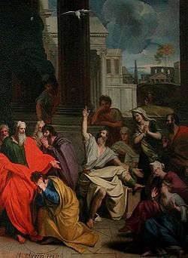
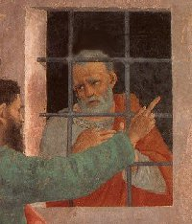
Agabus
Prophesied Paul to be bound by:
After we had been there a number of days, a prophet named Agabus came down from Judea. ¹¹Coming over to us, he took Paul’s belt, tied his own hands and feet with it and said, “The Holy Spirit says, ‘In this way the Jews of Jerusalem will bind the owner of this belt and will hand him over to the Gentiles’”
(Acts 21:10-11).
Is this a Spirit-inspired prophecy with
"inaccuracy of detail" (Grudem)? No!
• Jews (Acts 21:10-11)
• Romans (Acts 21:33)
• Jews caused the riot (21:27)!
"Then the [Roman] commander arrested him and ordered him bound with two chains. He asked the crowd who he was and what he had done
(Acts 21:33).
"The seven days were almost ended when some Jews from the province of Asia saw Paul in the Temple and roused a mob against him. They grabbed him (Acts 21:27).
Notes:
32

Slide 33
C. Prophets should take turns and be evaluated by other prophets (29-33a)
²⁹Let two or three people prophesy, and let the others evaluate what is said. ³⁰But if someone is prophesying and another person receives a revelation from the Lord, the one who is speaking must stop. ³¹In this way, all who prophesy will have a turn to speak, one after the other, so that everyone will learn and be encouraged. ³²Remember that people who prophesy are in control of their spirit and can take turns. ³³For God is not a God of disorder but of peace (NLT).
Notes:
33

Slide 34
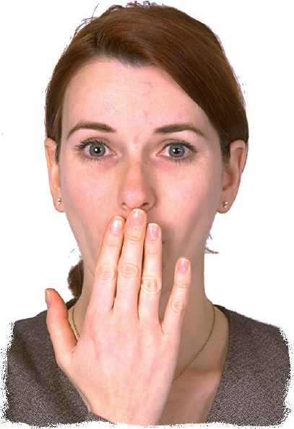
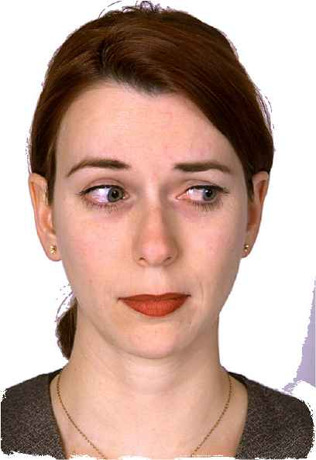
D. Women should ask their husbands questions at home (33b-35)
^{33b} As in all the meetings of God’s holy people,
³⁴women should be silent during the church meetings. It is not proper for them to speak. They should be submissive, just as the law says. ³⁵If they have any questions, they should ask their husbands at home, for it is improper for women to speak in church meetings (NLT).
Notes:
34

Slide 35

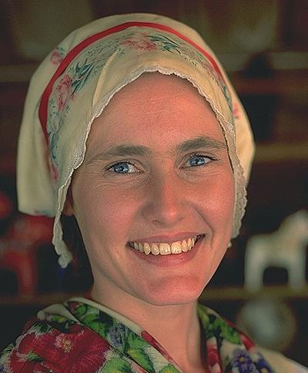
What’s a Woman to Do?
Reconciling the Main Texts
1 Cor. 11
?
1 Cor. 14; 1 Tim. 2
Wear a head covering when prophesying
Remain silent and be submissive in church
(1 Cor. 14:34; 1 Tim. 2:11)
Learn in quietness
(1 Tim. 2:11)
Do not teach or have authority over a man
(1 Tim. 2:12)
Notes:
35

Slide 36
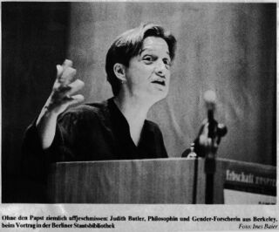
Why no women preachers at our church?
Notes:
36

Slide 37
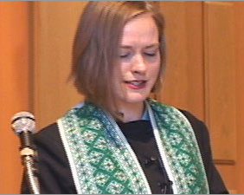
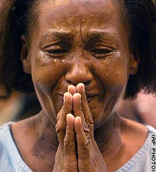
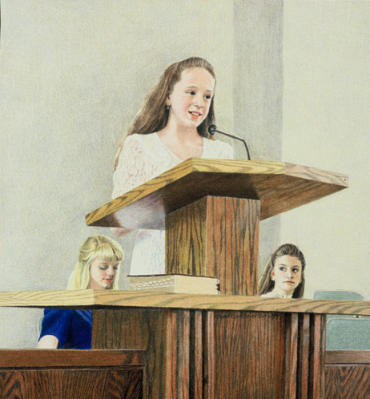
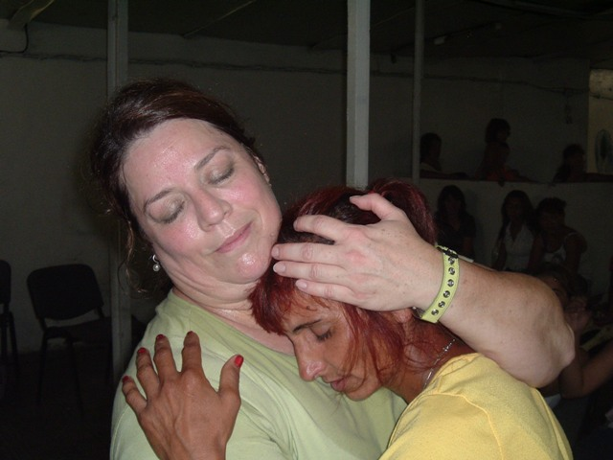
Reasons women can’t preach in church
Notes:
37

Slide 38

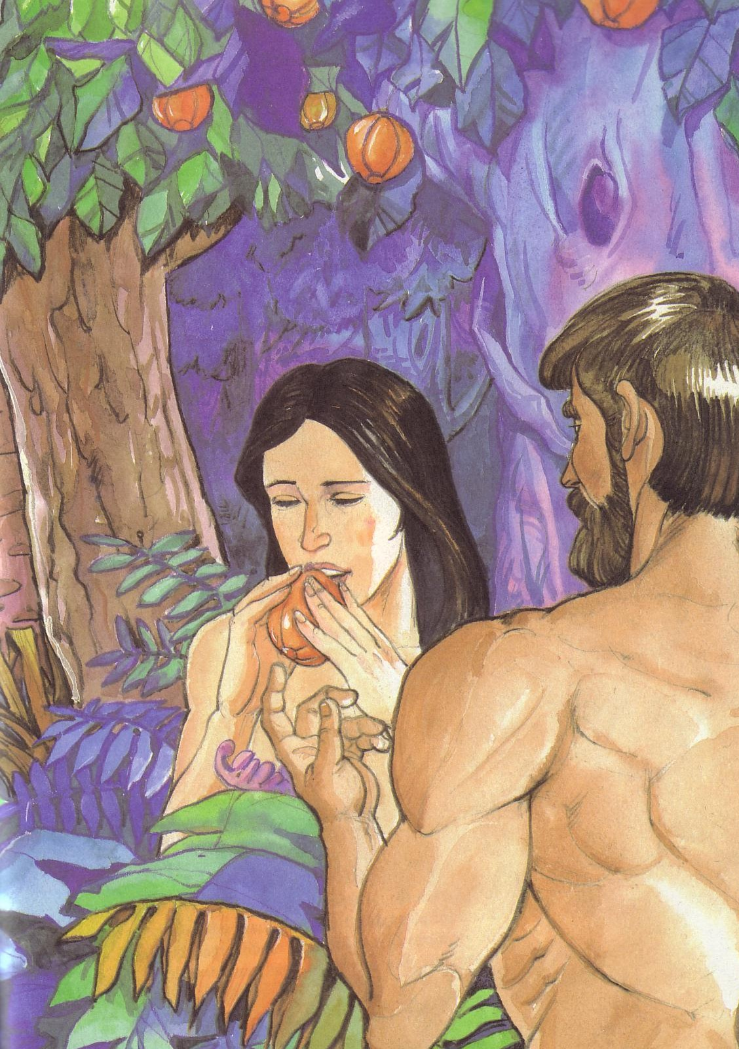
1 Timothy 2:11-15
¹¹A woman should learn in quietness and full submission. ¹²I do not permit a woman to teach or to have authority over a man; she must be silent.
¹³For Adam was formed first, then Eve. ¹⁴And Adam was not the one deceived; it was the woman who was deceived and became a sinner. ¹⁵But women {Gr. she} will be saved {or restored} through childbearing-- if they continue in faith, love and holiness with propriety.

Slide 39

II. Discipline those who disobey Christ’s speaking limitations
(36-38)
Notes:
39

Slide 40
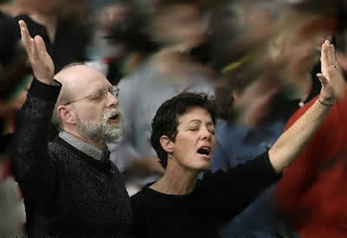
Equal Speaking in Church?
³⁶Or do you think God’s word originated with you Corinthians? Are you the only ones to whom it was given? ³⁷If you claim to be a prophet or think you are spiritual, you should recognize that what I am saying is a command from the Lord himself. ³⁸But if you do not recognize this, you yourself will not be recognized.
Notes:
40

Slide 41
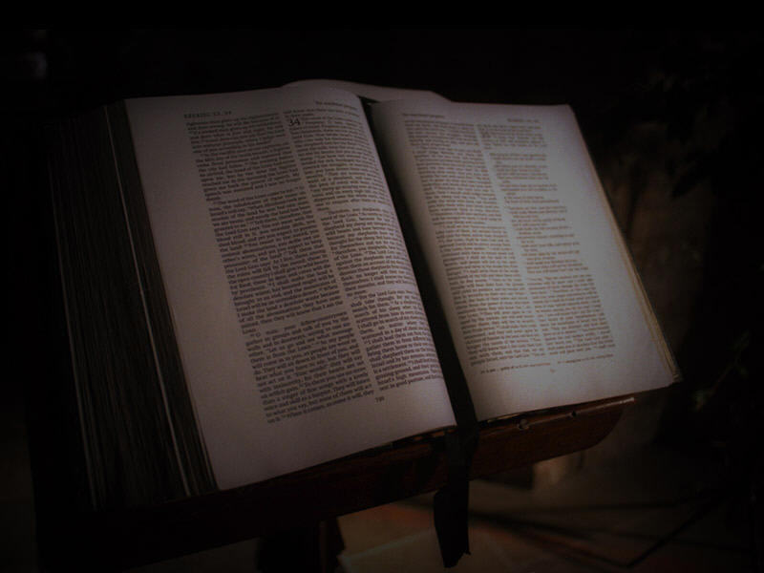
III. Emphasize prophecy without totally excluding tongues (39-40).
³⁹So, my dear brothers and sisters, be eager to prophesy, and don’t forbid speaking in tongues. ⁴⁰But be sure that everything is done properly and in order.
Notes:
41

Slide 42
Black
Notes:
42

Slide 43

Main Idea
Orderly
… is aided by having speaking limitations
Notes:
43

Slide 44
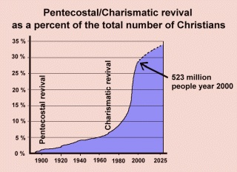
Pentecostals/ Charismatics as a Percent of the Total Number of Christians
Notes:
44

Slide 45
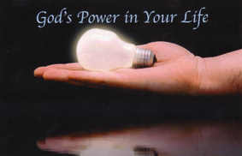
How can we be orderly yet edifying?
Notes:
45

Slide 46
Black
Notes:
46

Slide 47


NT Preaching link at BibleStudyDownloads.org
Get this presentation and script for free!
Notes:
NT Preaching (np)

